Slide 1
Design And Analysis of Algorithms
Department of Information Technology
-----Group Members-----
VIKRAM SINGH ( IIT2019213 )
AKSHAT AGRAWAL ( IIT2019214 )
RAVUTLA RUTHVIK ( IIT2019215 )
ASSIGNMENT-6 DEMONSTRATION
Under the Supervision of: Dr. Rahul Kala
Under the Mentorship of: Md Meraz

Slide 2
Contents
Problem statement
Algorithm-01
Description
Pseudo Code
Complexity
Algorithm-02
Description
Pseudo Code
Complexity
4. Algorithm-03
Description
Pseudo Code
Complexity
5. Conclusion

Slide 3
Problem Statement
The problem statement for the stock cutting problem is that given a stock of length n inches and an array of prices that contains prices of all pieces of size smaller than n. We have to determine the maximum value obtainable by cutting up the stock and selling the pieces.

Slide 4
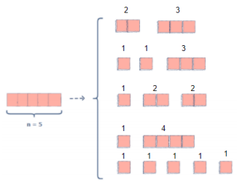

The answer is 12 (selling the sub-stocks of length 2+3 gives a 5+7=12 profit or of length 1+2+2 gives a 2+5+5=12 profit ).

Slide 5
Algorithm-01
Naive Algorithm - A naive solution for this problem would be to generate all the configurations, of all the different pieces, to find the highest priced configuration.

Slide 6
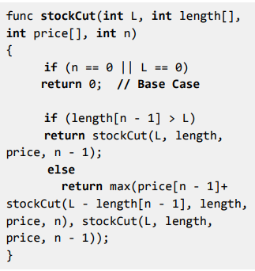
PSEUDO CODE

Slide 7
Time Complexity:
This method involves generating all the subsets for a given set of elements. The total number of subsets possible for a given set of elements is given by 2^{n} (where n is the number of elements). Thus this solution is Exponential in terms of time complexity.
Space Complexity:
There are two arrays of length n which are given to us. The number of variables involved in the recursive function are constant. Thus the space complexity would be O(n).

Slide 8
Algorithm-02
Using Memoization - This method uses Memoization Technique (an extension of recursive approach).
This method is basically an extension to the recursive approach so that we can overcome the problem of calculating redundant cases and thus increased complexity.

Slide 9
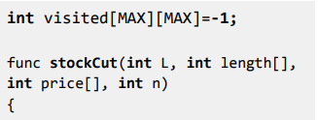
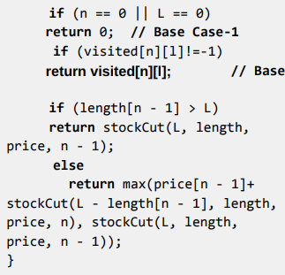
PSEUDO CODE

Slide 10
Time Complexity:
In this method all the redundant calculations are avoided. Thus we are left with two nested recursive calls in which the value of n reduces by 1 in every function call, uptill 0 . Thus the time complexity for this algorithm is O(n ² ).
Space Complexity:
There are two arrays of length n which are given to us. We then declare a 2-D array of size NxN. There is some stack memory used in the recursive functions in which the auxiliary space required is significantly lower than O(n ² ). Thus the overall space complexity for the algorithm would be O(n) + O(n² ) ≈ O(n² ).

Slide 11
Algorithm-03
Using Dynamic Programming - Since dynamic programming is mainly an optimization-over-plain recursion, we can use it to optimize the above exponential time algorithm.
The idea is to store the results of subproblems so that we do not have to re-compute them when they are needed.

Slide 12
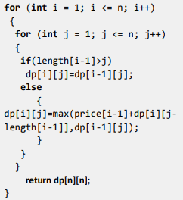
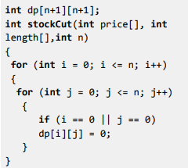
PSEUDO CODE

Slide 13
Time Complexity:
This method involves two nested-for loops in which we iterate from 1 to n. Thus the time complexity for this algorithm is O(n ² ).
Space Complexity:
There are two arrays of length n which are given to us. We then declare a 2-D array of size NxN. Thus the overall space complexity return dp[n][n];for the algorithm would be O(n) + O(n² ) ≈ O(n² ) .

Slide 14
CONCLUSION
In this report we have shown overall 3 algorithms to solve the Stock cutting problem.
First, we used the simple recursive algorithm to solve the problem. This algorithm, though fairly easy to understand and code, it’s time complexity was exponential which was way too much.
Second, we used the memoization technique which was merely an extension of the recursive algorithm. In this method all the redundant calculations are avoided. Thus the time complexity reduces drastically to O(n² ). Extra auxiliary space required increases from O(n) to O(n² ).
Third, we used dynamic programming. In this method, no recursion is involved. Only two nested for loops and a 2-D matrix are used. Thus the time complexity involved is O(n² ). Extra auxiliary space required is O(n² ). No extra stack memory is required, which was the case in the memoization technique.
Thus, we conclude that the algorithm involving dynamic programming is the best for solving the stock cutting problem as its time complexity is way better than that of the recursive method and its space complexity is slightly better than that of the memoization technique.

